Slide 1

Finding information for your project
Helen Staffer
Senghennydd Library
Stafferhb@Cardiff.ac.uk

Slide 2
By the end of the session you’ll be able to…
Source relevant information for your project proposal and presentation
Find journal articles for up to date research
Locate market research and industry news
Reference your sources correctly
…. to get better marks on your project

Slide 3

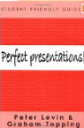

Researching Your Project
Business strategy books available in the Lifelong Learning Collection in Senghennydd Library and Aberconway Library…
& don’t forget
e-books – they’re available 24/7!
http://librarysearch.cf.ac.uk
Notes:
Book collections will support different elements of the project from developing a business strategy, effective project management, market research, swot analysis, branding and presentations

Slide 4

What are journal articles and why use them?
For research which is:
Up-to-date
In-depth
Academic quality
…to produce more substantial work which receives better marks!
http://www.bbc.co.uk/programmes/p01h1bsf
Notes:
I’m going to introduce you to some other resources that will provide relevant research whatever product you choose to develop for your project. Journal articles offer the most up to date research and information in all fields

Slide 5

Tip One
Clever keywords

Slide 6
Topic: Designing a website…
Equivalent terms | Equivalent terms | Broader / related terms | Narrower / related terms
Web site design | Web page layout | Web development | Interface design Graphic design
User experience | Web accessibility | Assistive technologies | text-to-speech software text-to-Braille hardware
Mark up language | HTML | Metadata and content | Dreamweaver
Notes:
Don’t just search within article titles – search all fields + retrieve better results as you’ll title – the summary / abstract and keywords added to an article to help you find it

Slide 7
Keyword phrases
“web design”
Alternate endings
Comput* for computers, computation
Combining keywords
“Interface design” OR “interface engineering” AND “user analysis”
Notes:
6.6 million hits on google scholar for web
6.2 million for design
72,000 for “web design”

Slide 8

Tip Two
Finding online journal articles on ArticleSearch

Slide 9
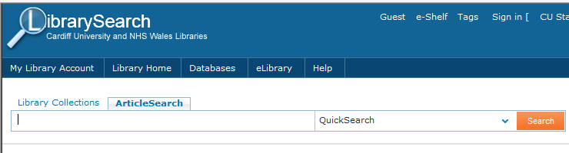
What is ArticleSearch?
A simple way to find some online journal articles…. it doesn’t cover all the online journals in the library collection but it is a quick and easy starting point:
http://librarysearch.cf.ac.uk
Notes:
Live search on article search for Mars Rover – all full text look for bib details for references – email option
Try advanced search to combine keywords enter “web design” and accessibility – look at results – use refine by subject to websites – look at results

Slide 10
Tip Three
Finding journal articles and market research through specialist databases

Slide 11
What are research databases?
Collections of references to research papers searchable by keywords
Identify peer-reviewed, high quality academic literature
Have specialised search facilities
Computing & Maths use:
MathSciNet
Web of Science

Slide 12
Market Research Databases
EBSCO Business Source Premier In addition to articles from scholarly and trade journals EBSCO also provides company profiles and DataMonitor market reports.
Passport Provides key business intelligence on countries, markets and companies worldwide. More than 330 consumer products in 52 countries are researched to produce value market sizes and forecasts.
KeyNote Provides market reports from 27 industries in the UK.
Mintel Marketing Intelligence Mintel provides access to the full text of a wide range of consumer-related UK market research reports.
Notes:
Search Mintel
UK – all reports – Technology – select 2013 – digital trends march 2013 – exec summary
In the search box look for apps – this will show the range of information available on Mintel – news – US & International BUT can select reports as an option for data/ trends etc
Keynote
Similar ability to brows reports alphabertically but also to search – advanced search for Apps – look at results

Slide 13
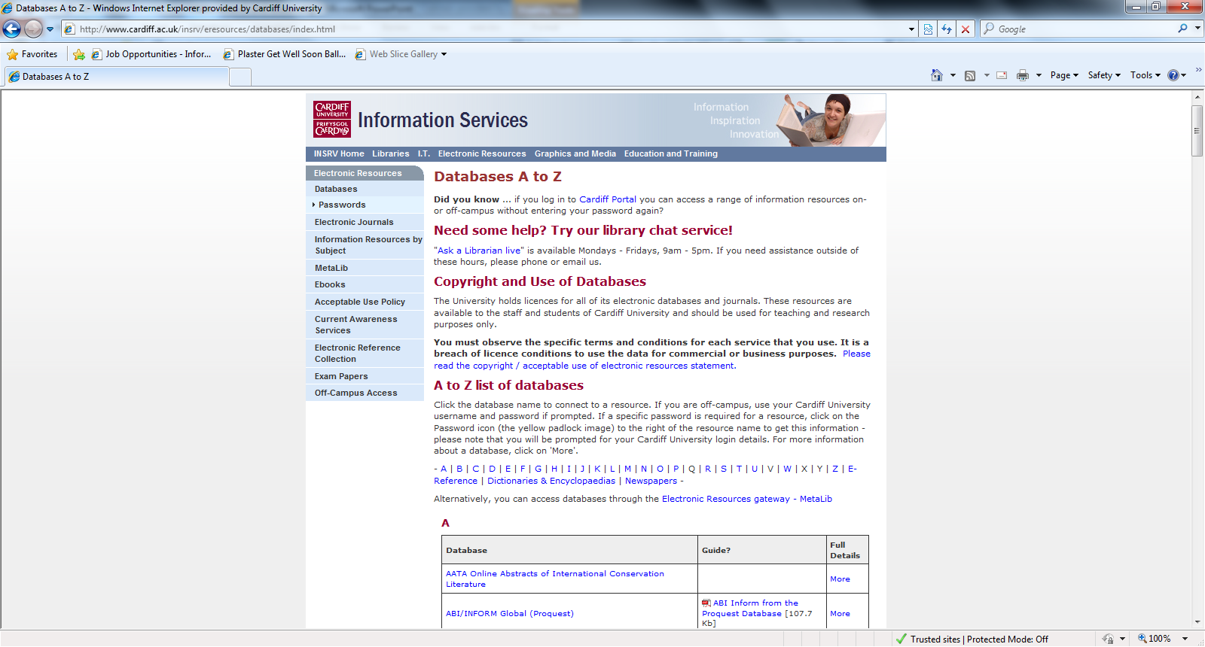
http://www.cardiff.ac.uk/insrv/eresources/databases/index.html

Slide 14
Tip Four
Don’t forget to cite & reference

Slide 15
Why reference?
Academic
Support your argument
Demonstrate wider reading
Don’t lose marks!
Practical
Enable reader to locate sources
Legal
Avoid being accused of plagiarism

Slide 16
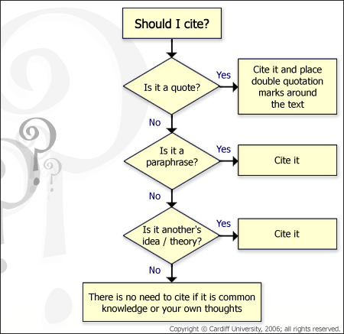

Slide 17
Citing within your text
It has been argued that the main consideration is cost [2], however Bennett suggests that corporate culture is an increasingly important factor [1].
References
1 Bennett, J. M. Legal issues in computer software. Paddington Books, London, 2006.
2 Lai, S.. The copyright protection of computer software in the United Kingdom. Hart, Oxford, 2000.
ACM Style

Slide 18
Referencing Books
Authors. Title. Publisher, City of Publication, Year of Publication.
Example:
1. Fogg, B.J. Persuasive technology: using computers to change what we think and do. Morgan Kaufmann Publishers, Boston, 2003.

Slide 19
Referencing Journal Articles
Authors. Title. Journal or magazine name, Volume (Issue), Pages.
Example:
1. Hirsh, H., Coen, M.H., Mozer, M.C., Hasha, R. and Flanagan, J.L. Room service, AI-style. IEEE intelligent systems, 14 (2), 8-19.

Slide 20
Referencing e-journals
Authors. Title. Journal or magazine name, Volume (Issue), Pages. Date retrieved: URL.
Example:
1. Hirsh, H., Coen, M.H., Mozer, M.C., Hasha, R. and Flanagan, J.L. Room service, AI-style. IEEE intelligent systems, 14 (2), 8-19. Retrieved February 12, 2014: http://ieeexplore.ieee.org/xpl/login.jsp?tp=&arnumber=757622&url=http%3A%2F%2Fieeexplore.ieee.org%2Fxpls%2Fabs_all.jsp%3Farnumber%3D757622.

Slide 21
Summary
Think about terminology / keywords
Search ArticleSearch for finding online journal articles quickly
Search databases such as Mintel & Keynote for more market research & business news
… reference your sources

Slide 22
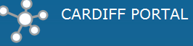
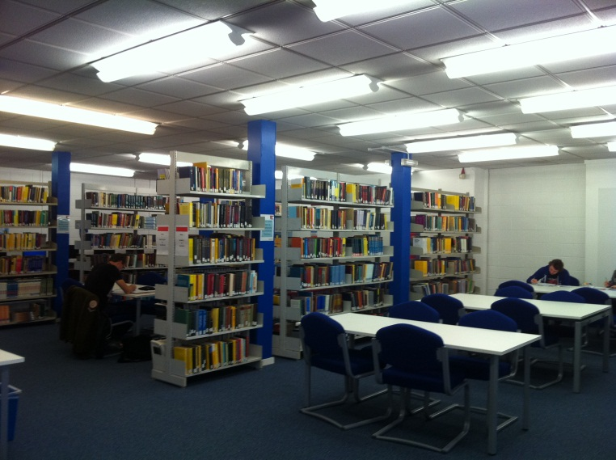
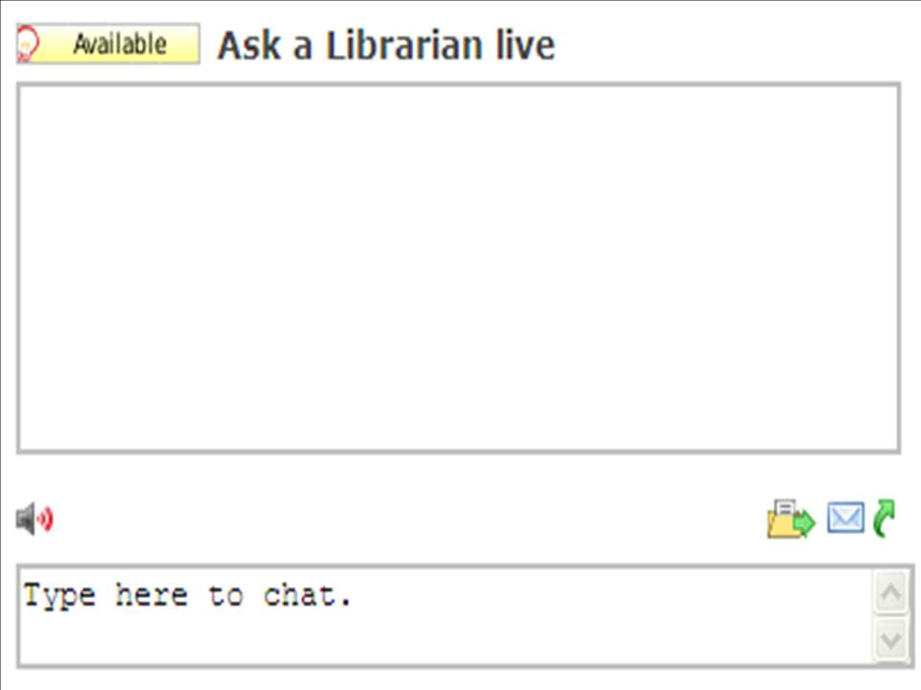
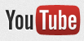
Help!
Pop in to the Library!
LibrarySearch FAQs
Ask questions via chat!
CardiffUniLib
channel

